Slide 1
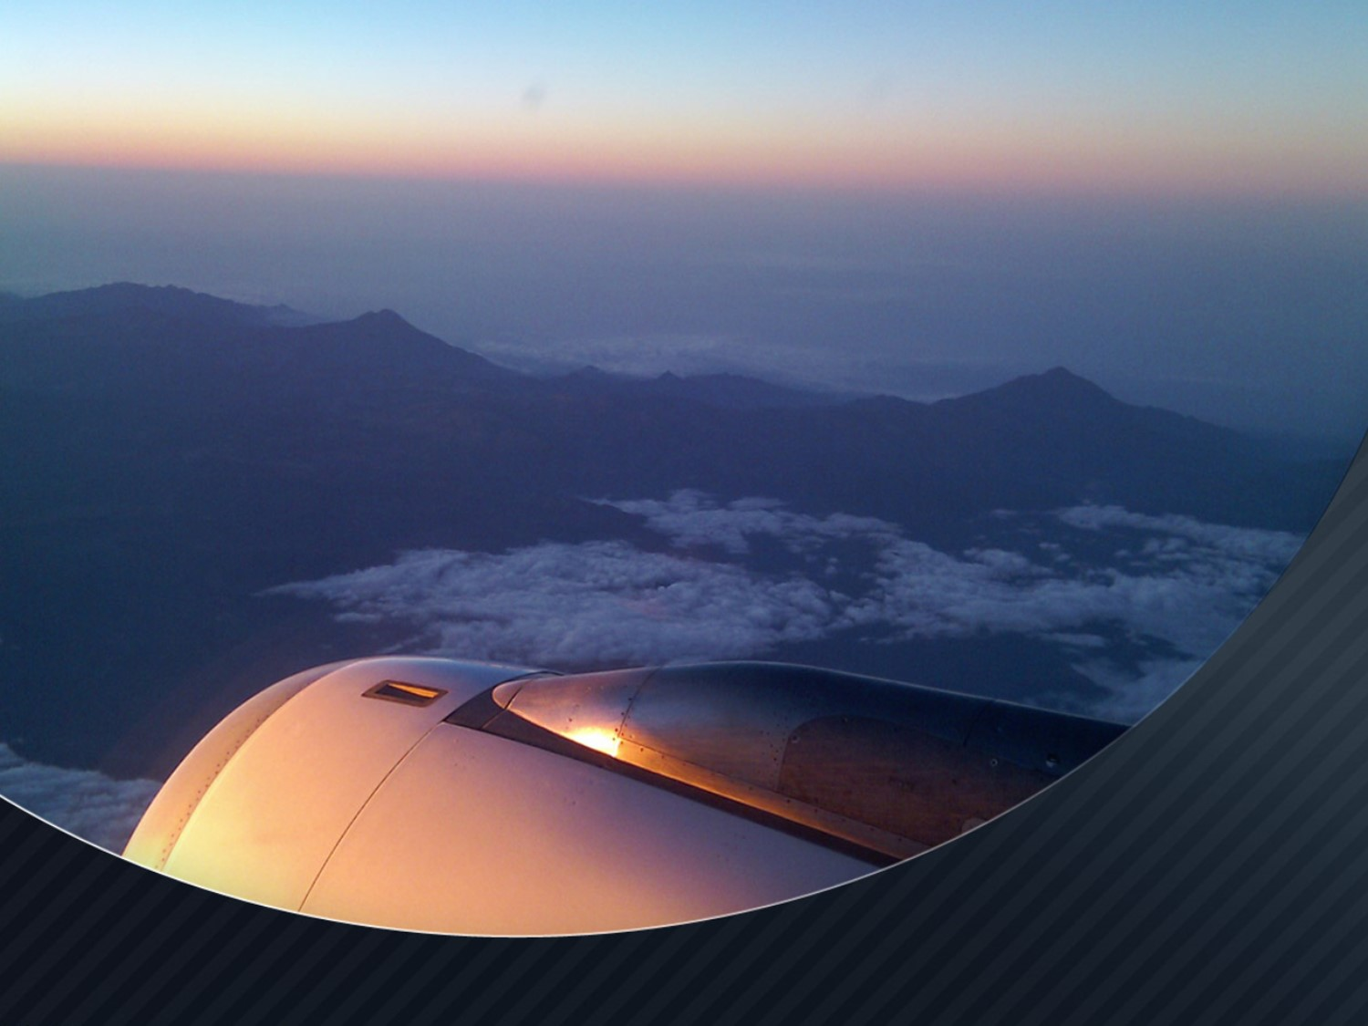
Predictive Modeling of Flight Delay Characteristics to Optimize Operational Performance
Shilpa Balan, Asst. Professor
Zeeshan Khan, Masters Candidate
Swarnim Jambhule, Masters Candidate
Ruchita Shinde, Masters Candidate
Department of Information Systems
California State University, Los Angeles

Slide 2
INTRODUCTION
Air transportation is a critical infrastructure that serves nearly 7 billion passenger enplanements a year, about 800 million of which are in the United States (Gopalakrishnan and Balakrishnan, 2017)
Digital age: minute news and weather from all over the world sent to our smartphones
Extreme weather conditions: most common causes of flight delays and cancellations
Wide range of weather conditions and flight delays
Flight delays are inconvenient for the passengers
Aim of this research: Prediction of flight delays to alleviate the stress that they bring to our lives
Notes:
http://www.mit.edu/~hamsa/pubs/GopalakrishnanBalakrishnanATM2017.pdf
Wide range of weather conditions but in the event of newsworthy weather they are likely to be temporarily grounded.
If only there were some way in which we could predict flight delays and mitigate the stress and the strain that they bring to our lives.

Slide 3
MOTIVATION AND BACKGROUND
Modern day challenge: managing the disruption of flight delays
Approximately 20% of airline flights are delayed or cancelled, costing over 20 billion dollars in lost time and money (Lawson and Castillo, 2012)
Delays propagate in airspace systems due to air traffic networks (Gopalakrishnan and Balakrishnan, 2017)
This study demonstrates the prediction of arrival delay by the application of Random Forest machine learning algorithm
Notes:
http://citeseerx.ist.psu.edu/viewdoc/download?doi=10.1.1.278.3892&rep=rep1&type=pdf
Challenge of smoothly managing the disruption of flight delays has longed weighed on airline and airport executives’ minds.
Approximately 20% of airline flights are delayed or cancelled, costing over 20 billion dollars in lost time and money (Lawson and Castillo, #year)
Air trafﬁc delay prediction has also been an active topic of research over the past few years.

Slide 4
LITERATURE REVIEW
Qianya, Lei, Rong, Bin, & Xinhong (2015), and Rong, Qianya, Bo, Jing, & Dongdong (2015) have presented a method of analysis for flight delays based on Bayesian Networks that could analyze and predict the delay during a flight
AhmadBeygi, Cohn, Guan, & Belobaba (2008) analyzed the potential for delays to spread due to airlines; they used propagation trees to compare airlines.
Zonglei, Jiandong, & Tao (2009) focused on predicting the seriousness of the delay at specific airports to monitor airport delays and alerting specific airports through a recommendation system
Notes:
AhmadBeygi, Cohn, Guan, & Belobaba (2008) - They concluded that the key points that had an impact on slowing the spread of delay were when cabin crews end their shift, and when cabin crew and airplanes were always together on all planned flights.
https://run.unl.pt/bitstream/10362/42529/1/TGI0160.pdf

Slide 5
EXAMPLE OF A DELAY NETWORK
BOS
4
JFK
20
5
5
SFO
2
DFW
1
ATL
5
Reference: Gopalakrishnan and Balakrishnan (2017)
Notes:
http://www.mit.edu/~hamsa/pubs/GopalakrishnanBalakrishnanATM2017.pdf

Slide 6
DATA SET
We used the dataset on: The Bureau of Transportation Statistics’ (BTS) Airline On-Time Performance dataset (BTS, 2019).
The Bureau of Transportation Statistics (BTS) which improves the quality and effectiveness of the Department of Transportation's statistical programs, provides compiled data on U.S. transportation systems.
BTS is part of the Research and Innovative Technology Administration (RITA) - a unit of the US Department of Transportation (DOT) - and is one of the lead agencies in the U.S. Federal Statistical System
The data of interest comes from service of the BTS, Transtats, a database with information on on-time performance.
The BTS dataset contains an exhaustive listing of flights to and from in the US since 1987 and includes features such as departure date, airline carrier, origin airport, number of minutes delayed, and more.
The dataset selected for this study is composed of records of all USA domestic ﬂights of major airlines for the year 2018, with two diﬀerent perspectives, one focused on the departures and the other one on the arrivals.
Notes:
https://www.transtats.bts.gov/DL_SelectFields.asp?Table_ID=236

Slide 7
DATA SET
For each ﬂight were recorded:
  DAY_OF_WEEK: Day of Week.
  DEST: Destination Airport
  DEP_DELAY: Difference in minutes between scheduled and actual departure time. Early departures show negative numbers.
  DEP_DEL15: Departure Delay Indicator, 15 Minutes or More (1=Yes,0=No)
  ARR_DEL15: Arival Delay Indicator, 15 Minutes or More (1=Yes,0=No)
  CARRIER_DELAY: Delay caused by delay, in Minutes.
  WEATHER_DELAY: Delay caused by weather, in Minutes.

Slide 8
METHODOLOGY
Data Set
Feature Extraction
Train Data
Test Data
Exploratory Data Analysis
Random Forest Classifier

Slide 9
METHODOLOGY
For the part of exploratory data analysis, we used Tableau, a popular data visualization software
Exploratory Data Analysis (EDA) is an approach to analyze the data and see its main characteristics as well as its behavior, either alone as together with the dependent variable, with no clear ideas of what to look for (Peng, 2015).
For predictive analytics, we used Weka and Python to implement Random forest machine learning algorithm
A random forest is a meta estimator that fits a number of decision tree classifiers on various sub-samples of the dataset and uses averaging to improve the predictive accuracy and control over-fitting (Scikit Learn, 2018).
Notes:
https://scikit-learn.org/stable/modules/generated/sklearn.ensemble.RandomForestClassifier.html
https://towardsdatascience.com/the-random-forest-algorithm-d457d499ffcd

Slide 10
LOAD FACTOR
Load factor: represents the proportion of airline output that is actually consumed; calculated as the Revenue Passenger Miles (RPMs) per Available Seat Miles (ASMs) (BTS, 2019).
The highest Load factor reached 86.03% was recorded for Grand Canyon Airlines Inc. (Scenic Airlines for The Grand Canyon Tours)
The lowest Load factor was recorded 0% for Airlines Bemidji, Caribbean Sun, Grand Canyon Helicopters and Ward Air
Notes:
URL “https://www.bts.dot.gov/newsroom/2017-annual-and-december-us-airline-traffic-data”, Website Title “2017 Annual and December U.S. Airline Traffic Data | Bureau of Transportation Statistics”, Article Title Airline Traffic Data.

Slide 11
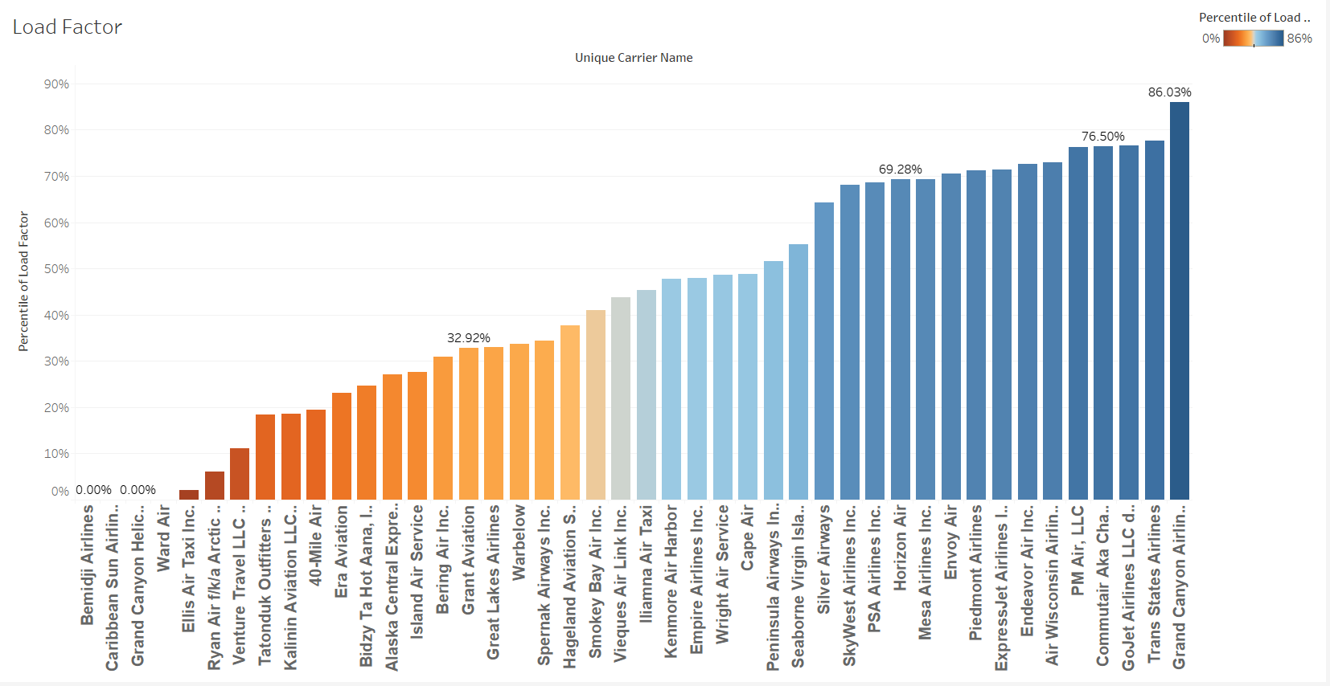
LOAD FACTOR

Slide 12
AIRLINE REVENUE BASED ON
PASSENGER ENPLANEMENT
Total Revenue Passenger Enplanement is calculated as the Scheduled Revenue Passenger Enplaned minus the Non-Scheduled Revenue Passenger Enplaned (BTS, 2019).
The highest revenue passenger enplanement was recorded for SkyWest Airlines Inc. at $29,082,524
The Grand Canyon Airlines incurred an extreme loss of $175,694 in the year 2018 for revenue passenger enplaned
Notes:
SkyWest Airlines is a leading regional airline serving millions of North America travelers monthly
URL “https://www.bts.dot.gov/newsroom/2017-annual-and-december-us-airline-traffic-data”, Website Title “2017 Annual and December U.S. Airline Traffic Data | Bureau of Transportation Statistics”, Article Title Airline Traffic Data.

Slide 13
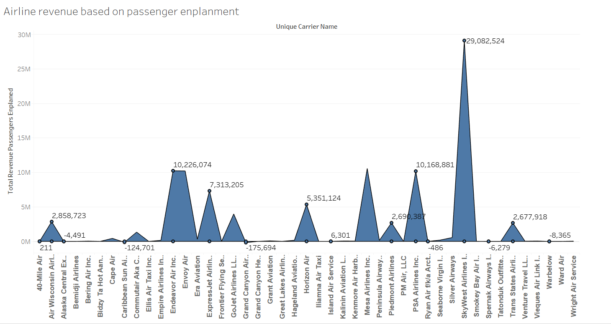
AIRLINE REVENUE BASED ON
PASSENGER ENPLANEMENT

Slide 14
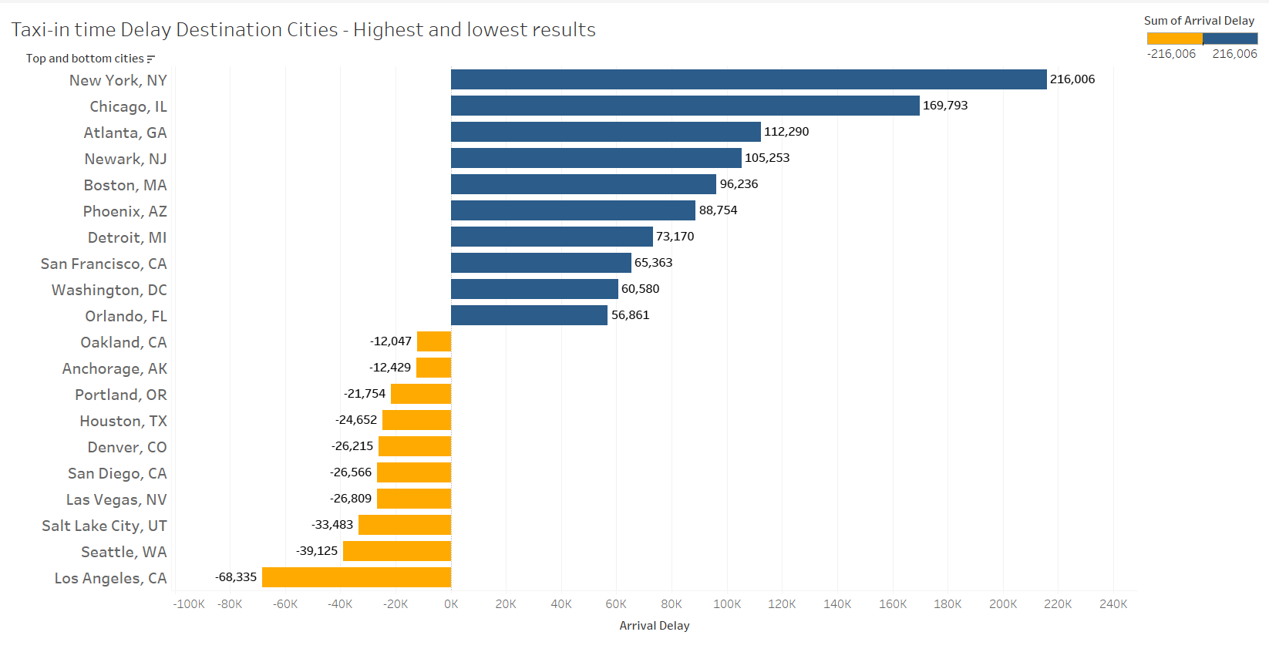
DESTINATION CITIES WITH HIGHEST AND
LOWEST TAXI-IN TIME DELAYS
Notes:
The destination city with highest arrival delay is reported for city of New York, NY followed by Chicago, IL and Atlanta, GA.
The lowest arrival delays were reported for City of Los Angeles, CA followed by Seattle, WA.

Slide 15
TOP DESTINATION CITY AIRPORT
BASED ON ARRIVAL DELAY
Cities with multiple airports have a huge difference in arrivals delays of aircrafts
O'Hare International Airport, Chicago is reported to have the highest arrival delays in comparison to the Midway airport of Chicago which has the lowest arrival delays
LaGuardia airport of New York is the second airport after Chicago O’Hare to have a huge number of arrival delays as compared to John F Kennedy airport which has moderate delays in arrival

Slide 16
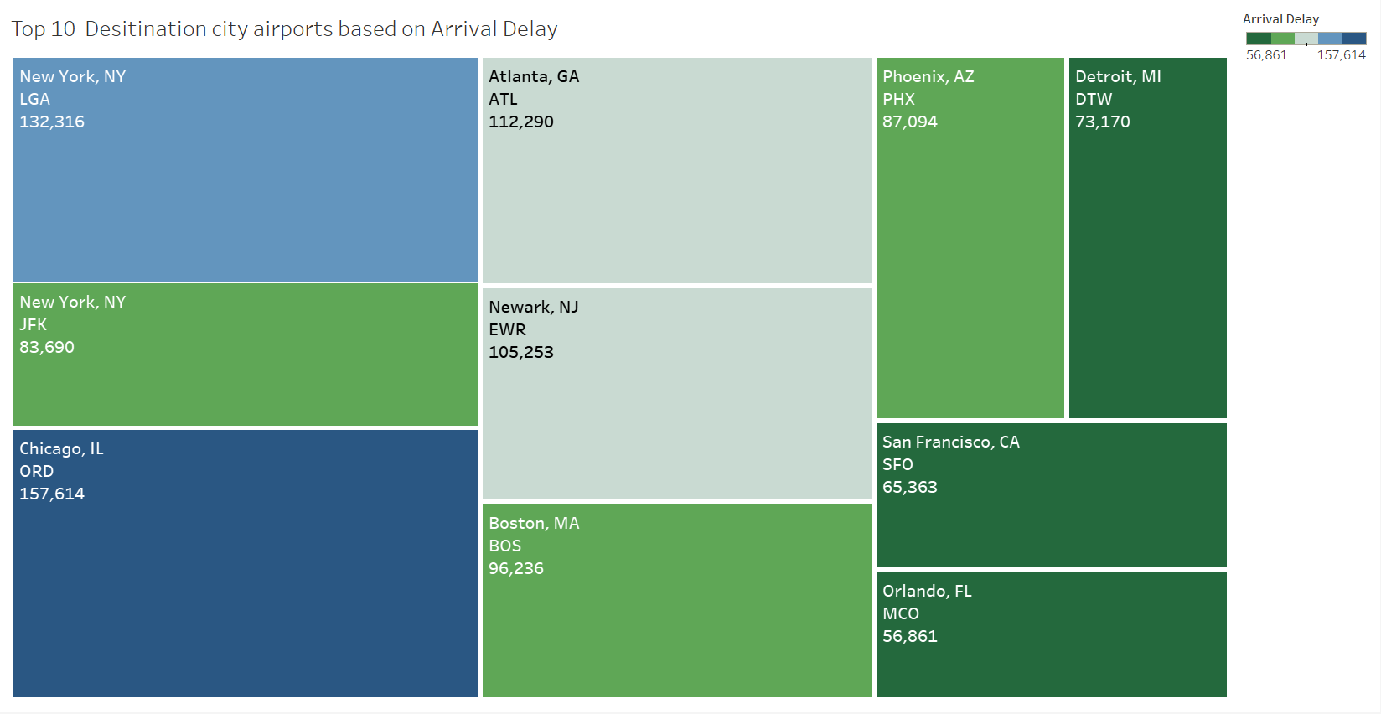
TOP DESTINATION CITY AIRPORT
BASED ON ARRIVAL DELAY

Slide 17
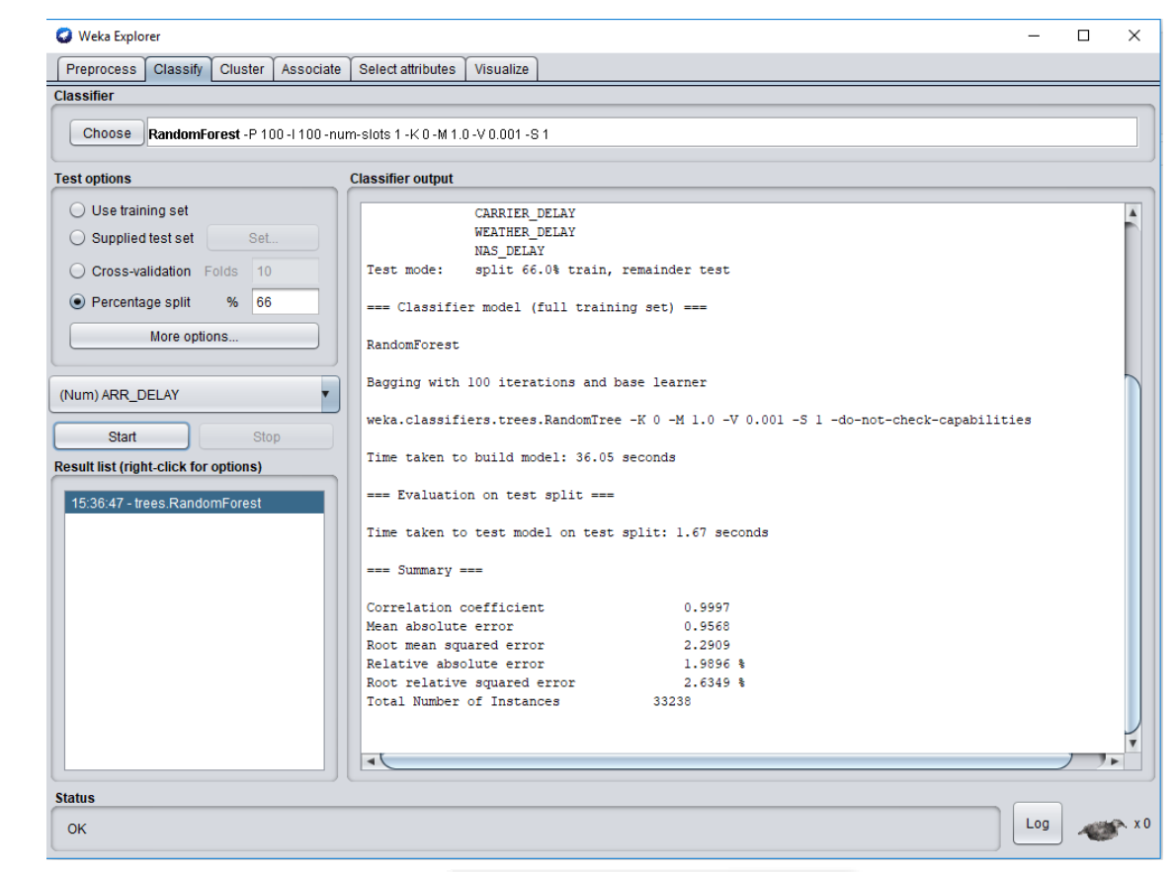
PREDICTION
Notes:
Perceiving whether the delay occurred at a time different from the arrival time at the airport of origin
Rebollo, J. J., & Balakrishnan, H. (2014). Characterization and prediction of air traffic delays. Transportation Research Part C: Emerging Technologies, 44, 231–241. https://doi.org/10.1016/j.trc.2014.04.007
https://run.unl.pt/bitstream/10362/42529/1/TGI0160.pdf

Slide 18
PREDICTION- PSEUDOCODE
data = pd.read_csv('data.csv')
from sklearn.cross_validation import train_test_split
X=data[['DAY_OF_WEEK', ‘’DEST’, CARRIER_DELAY', 'WEATHER_DELAY’, ‘TAXI_IN’]]
y=data['ARR_DEL15']
X_train, X_test, y_train, y_test = train_test_split(X, y, test_size=0.70)
from sklearn.ensemble import RandomForestClassifier
clf=RandomForestClassifier(n_estimators=100)
clf.fit(X_train,y_train)
y_pred=clf.predict(X_test)
Notes:
Our results indicate that flight delays can occur due to carrier delay, taxi-in time, weather delay or based on the destination.

Slide 19
CONCLUSION AND FUTURE RESEARCH
Our results indicate that flight delays can occur due to carrier delay, taxi-in time, weather delay or based on the destination.
Flight delays hurt airlines, airports, and passengers (Sternberg et al., 2017)
In this context, this study presents a thorough review of approaches used to build ﬂight delay prediction models from the Data Science perspective
For future research, we plan to look at specific seasons or holidays in the year to analyze flight delays

Slide 20
REFERENCES
AhmadBeygi, S., Cohn, A., Guan, Y., & Belobaba, P. (2008). Analysis of the potential for delay propagation in passenger airline networks. Journal of Air Transport Management, 14(5), 221–236.
BTS (2019). Bureau of Transportation Statistics. Retrieved from https://www.transtats.bts.gov/DL_SelectFields.asp?Table_ID=236
Gopalakrishnan and Balakrishnan (2017). A Comparative Analysis of Models for Predicting Delays in Air Traffic Networks. Twelfth USA/Europe Air Traffic Management Research and Development Seminar.
Lawson, D. and Castillo, W. Predicting flight delays. Tech-nical report, Computer Science Department, CS 229, Stanford University, Stanford, CA, 2012.
Peng, R. (2015). Exploratory Data Analysis with R. Leanpub.
ScikitLearn (2018). Random Forest Classifier. Retrieved from https://scikit-learn.org/stable/modules/generated/sklearn.ensemble.RandomForestClassifier.html

Slide 21
REFERENCES
Sternberg, Alice & Soares, Jorge & Carvalho, Diego & Ogasawara, Eduardo. (2017). A Review on Flight Delay Prediction.
Qianya, L., Lei, W., Rong, F., Bin, W., & Xinhong, H. (2015). An Analysis Method for Flight Delays based on Bayesian Network. Proceedings of the 2015 27th Chinese Control and Decision Conference, CCDC 2015, 2561–2565.
Zonglei, L., Jiandong, W., & Tao, X. (2009). A New Method for Flight Delays Forecast Based on the Recommendation System. ISECS International Colloquium on Computing, Communication, Control and Management, 1, 46–49. https://doi.org/10.1109/CCCM.2009.5268153

